Slide 1

OpenAI
DevDay Exchange
A little help with
everyday work
Cambridge, 28 October 2026
Lili Zhu and Alexandra Tran
Notes:
00–02. Welcome new and returning participants. Lili: “Today we will talk through an idea, make a useful draft and improve it. We will finish with a short look at Dots.” No coding or Dots access required. Time and room await confirmation.
Visual source: supplied DDE artwork or cited official guide.
Native fade transition on click. No automatic slide advance.

Slide 2
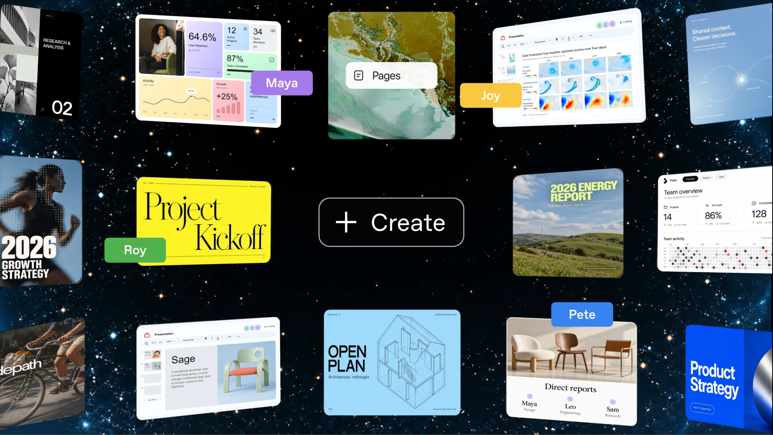
Something useful by the end
A short roundup.
A clearer plan.
A page you can share.
DevDay Exchange Cambridge
02
Notes:
02–05. Alexandra gives everyday examples: a club roundup, a study plan or a short event guide. Everyone will practise one draft and one improvement. Pairing and paper practice are welcome. We use the same beginner roundup for a shared example. Official image: Pages and collaboration in the supplied DevDay recap.
Visual source: user-supplied OpenAI DevDay 2026 Community Edition recap.
Native fade transition on click. No automatic slide advance.

Slide 3
Three ways to work
Chat
Work
Codex
Ask and explore
Finish a task
Build software
Choose a starting point. You can still talk naturally.
DevDay Exchange Cambridge
03
Notes:
05–08. Chat helps you discuss an idea. Work helps make a deliverable, including a plan or document. Codex builds and changes software. These are starting points with overlapping capabilities. This hour uses an ordinary one-run task; no coding knowledge is needed. Source: https://learn.chatgpt.com/docs/use-chatgpt
Visual source: supplied DDE artwork or cited official guide.
Native fade transition on click. No automatic slide advance.

Slide 4
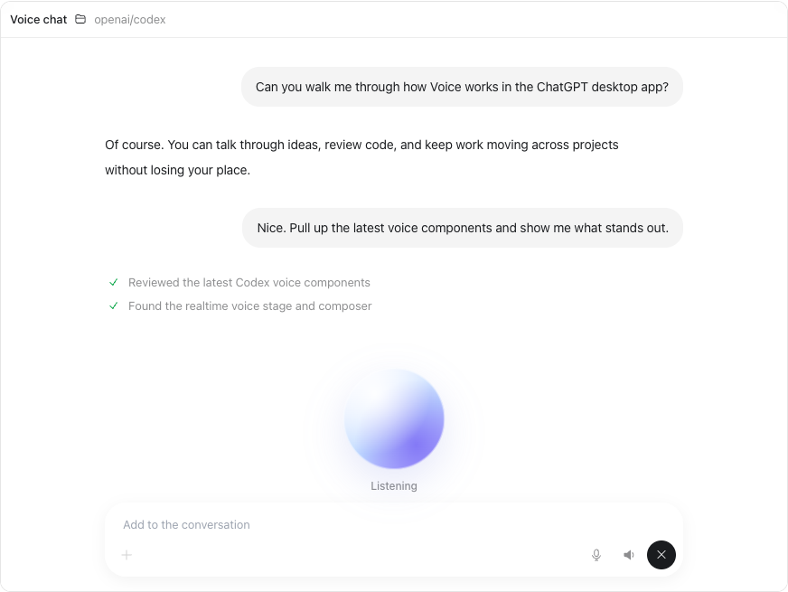
An idea you can talk through
60-second Voice demo
Say it
Help me plan a beginner book club. Ask me one question first.
Change your mind
“Actually, make it ten minutes.”
Official guide illustration
Check the new plan. End the call.
DevDay Exchange Cambridge
04
Notes:
08–10. Alexandra drives a single 60-second Voice demo; Lili narrates. No Appshots demo in this session. The aim is a two-way conversation and one visible correction, not dictating text.
PRE-FLIGHT: Confirm Start new voice chat is available on the teaching account in the current desktop app. Rehearse microphone permission, output speaker volume and projector audio. Use fictional material in a fresh chat; leave Screen context off. Close any other active voice chat. Keep the typed prompt and a labelled sample brief ready.
08:00–08:20 INTRO. Lili: “You can talk an idea through and change your mind out loud.”
08:20–08:30 START. Alexandra selects Start new voice chat and says: “Help me plan a beginner book club. Ask me one question first.”
08:30–08:45 ANSWER. Let the assistant ask its question. Reply naturally, then add: “Four friends, twenty minutes, and no homework.”
08:45–09:05 STEER. Say: “Actually, make it ten minutes. Give me a two-line plan here. Don't start another task.” Point out the correction in ordinary language.
09:05–09:20 CHECK AND STOP. Inspect whether the final brief uses ten minutes and no homework. Say “That changed the plan.” Select Stop voice chat. Do not claim it succeeded if the result misses a constraint.
09:20–10:00 DEBRIEF. Ask the room for one everyday situation where speaking is easier. Take one answer. This is live conversation; dictation only turns speech into text.
FALLBACK: Allow at most 15 seconds to recover. If Voice or room audio fails, type the same exchange and label it a typed fallback. If there is no response by 09:05, use the prepared sample, explicitly labelled example: “Ten-minute book club for four friends. Each shares one short passage; no homework.” Do not imitate a live answer or spend the session on setup.
Source checked 13 October 2026: https://learn.chatgpt.com/docs/features/voice . Availability depends on plan, rollout and workspace. Official Voice illustration captured from that page, not a live workshop conversation.
Visual source: supplied DDE artwork or cited official guide.
Native fade transition on click. No automatic slide advance.

Slide 5
The pace of updates
122
dated changelog entries
May 2025 to
8 October 2026
May 2025
Jan 2026
Oct*
Each dot = one entry. Play the update wall ↗
Features, fixes and model changes. Indexed 12 Oct; *October is partial.
DevDay Exchange Cambridge
05
Notes:
10:00–11:00. Lili: “Each dot is one dated changelog entry. Some contain several improvements. This is why keeping up can feel like a lot. You only need the changes useful to your own work.” Let the room notice the volume before naming features. The 122 entries run from 19 May 2025 to 8 October 2026, indexed on 12 October. The official feed checked again 13 October still begins with 8 October. Includes features, fixes, model changes and retirements. This is a curated ChatGPT and Codex feed, not all OpenAI releases and not 122 new features. July 2025 has zero indexed entries. October is a partial month. Exact monthly counts and entry metadata live in research/codex-release-index.json and the animated guide visual. Source: https://learn.chatgpt.com/docs/changelog . The small purple markers are data, not Dot characters.
Visual source: supplied DDE artwork or cited official guide.
Native fade transition on click. No automatic slide advance.

Slide 6
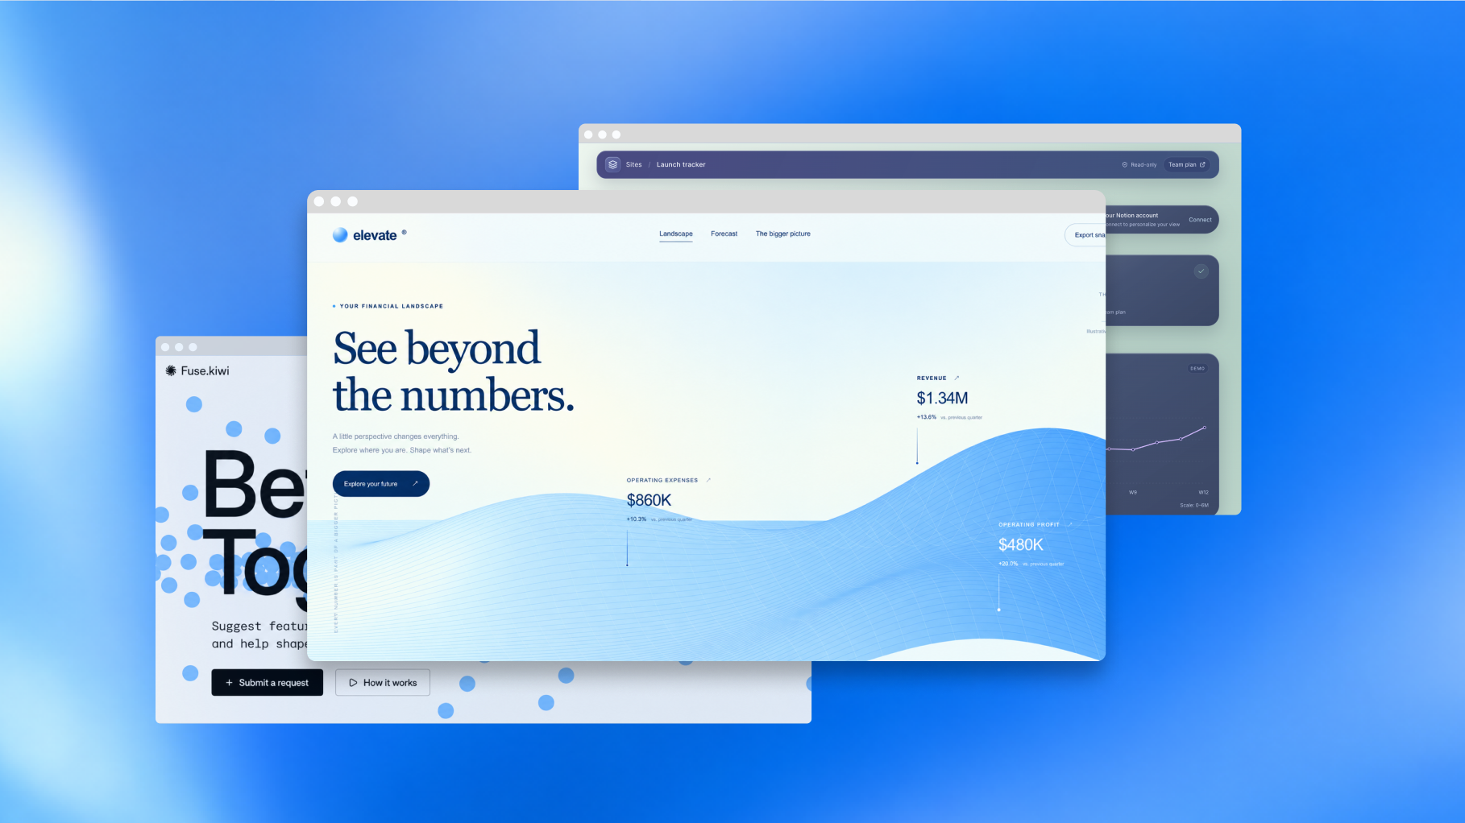
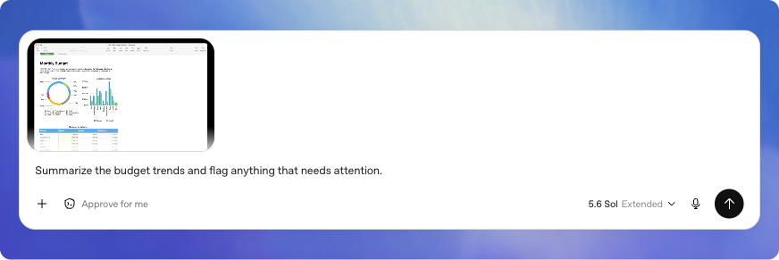
Useful without writing code
May 2026
June 2026
July 2026
September 2026
Show a screen
Share a page
Talk an idea through
Create together
Appshots
Sites
Voice
Pages and Space
Selected milestones. Availability depends on your account.
DevDay Exchange Cambridge
06
Notes:
11:00–12:00. Lili connects selected milestones to ordinary work: May Appshots, show the page you mean; June Sites, make a shared checklist; July Voice, talk through an idea and steer it; September Pages/Space, make and improve documents with others. These are selected uses, not a claim that every account has every feature. Four product images are official illustrations, not evidence of today's live account. Source: https://learn.chatgpt.com/docs/changelog ; https://learn.chatgpt.com/docs/features/voice ; https://learn.chatgpt.com/docs/whats-new/devday-2026 . Dates label selected announcements, not universal availability. Dots is one further DevDay development covered briefly at the end of session two.
Visual source: supplied DDE artwork or cited official guide.
Native fade transition on click. No automatic slide advance.

Slide 7
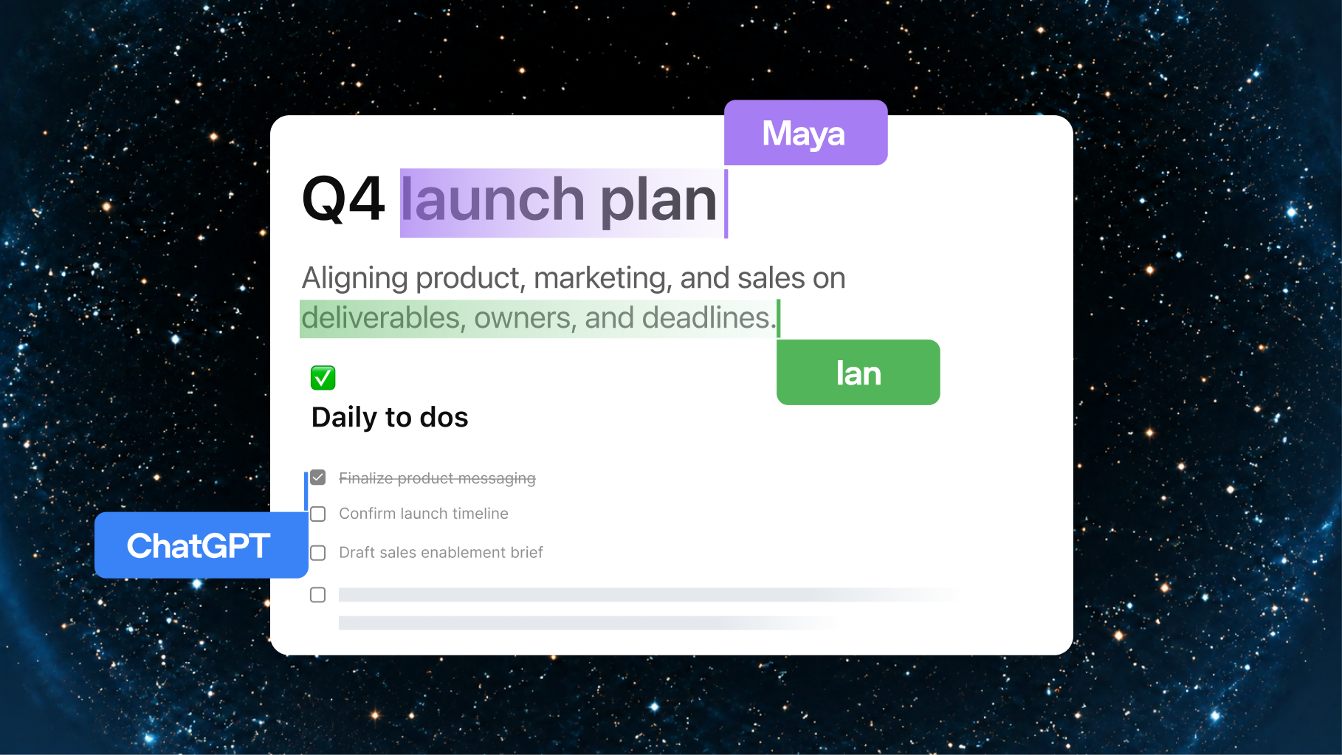
A useful draft, with evidence
One short roundup.
One source check.
One better instruction.
DevDay Exchange Cambridge
07
Notes:
12–20. Alexandra runs the guide’s fictional cards in an ordinary ChatGPT task. Ask for a short beginner roundup, using only the cards. Keep A once, drop its duplicate B and advanced card C, and mark D’s date unknown. Do not invent URLs. Inspect a source card, then correct one instruction. This models research, planning and writing. No Dots account or schedule needed. If slow at 16 minutes, show a labelled prepared example. Lili asks what the draft missed.
Visual source: user-supplied OpenAI DevDay 2026 Community Edition recap.
Native fade transition on click. No automatic slide advance.

Slide 8
A brief for a useful draft
Who will use it?
What should it produce?
What must it get right?
DevDay Exchange Cambridge
08
Notes:
20–25. Lili points to the roundup prompt. Participants can use the sample cards or fictional details for a plan or short guide. Specify audience, format and a check. Keep the work to one draft. Ask for missing facts rather than inventing them. Alexandra checks everyone has a next step.
Visual source: supplied DDE artwork or cited official guide.
Native fade transition on click. No automatic slide advance.

Slide 9
20 minutes to try it
Make a first draft.
Check something real.
Improve the brief.
DevDay Exchange Cambridge
09
Notes:
25–40. Hosts circulate. At 28 minutes offer the paper/sample route. At 35 minutes swap roles. Reviewer checks one claim, date or constraint against the input. One useful change is enough. No schedules or account connections needed. At 39 minutes announce checking time.
Visual source: supplied DDE artwork or cited official guide.
Native fade transition on click. No automatic slide advance.

Slide 10
A draft you can trust more
A claim matches its source.
Missing facts stay visible.
The result fits its reader.
DevDay Exchange Cambridge
10
Notes:
40–45. Check the sample for duplicates, missing dates and level. For an alternative plan, verify a stated constraint. Revise one instruction and rerun only the relevant part. Sending or publishing requires a separate decision.
Visual source: supplied DDE artwork or cited official guide.
Native fade transition on click. No automatic slide advance.

Slide 11
One useful improvement
What did you make?
What did you change?
What did you check?
DevDay Exchange Cambridge
11
Notes:
45–50. Up to three one-minute share-backs. Lili invites a noncoding example; Alexandra checks the timing. A careful correction is a useful outcome.
Visual source: supplied DDE artwork or cited official guide.
Native fade transition on click. No automatic slide advance.

Slide 12

When the same job comes back
Dots can help between chats.
Start with one clear job.
Dots is optional. A one-run draft is a complete submission.
DevDay Exchange Cambridge
12
Notes:
50–52. Optional two-minute Dots introduction. Show Iggy, but focus on the example: a recurring beginner roundup. A good brief says which sources to use, what needs review and when to stop. UK personal Pro Dots access was unavailable at the 12 October check; consult live access docs before the event. The ordinary one-run task is a complete workshop route. Activity shows actions; Scheduled shows repeating jobs. Pause does not stop all delegated tasks or schedules. 52–54. Take-home: improve a brief after one useful draft and one awkward test. Dots is optional. Deadline 1 November 2026, 11:59pm UK. Sources: https://learn.chatgpt.com/docs/dots ; https://learn.chatgpt.com/docs/dots/controls
Visual source: official OpenAI Learn Dots page, https://learn.chatgpt.com/docs/dots . Illustrations are supplied by the product guide, not workshop account screenshots.
Native fade transition on click. No automatic slide advance.

Slide 13
Your next useful task
Guide, prompts and examples
Questions welcome
Submit your challenge
Cambridge Codex · Take-home challenges
Sign in to save privately. Your deadline is on the submission site.
Open workshop guide
Cambridge Codex · Prompts, examples and resources
DevDay Exchange Cambridge
13
Notes:
54–60. Q&A and submission link. Submit a plan, roundup, page or a Dots rehearsal, with one improvement and one check. Close on time. Deadline 1 November 2026, 11:59pm UK.
Visual source: supplied DDE artwork or cited official guide.
Native fade transition on click. No automatic slide advance.

