Slide 1

Your first useful build.
Cambridge Codex
Community
A friendly hour with Codex, Appshots and Sites.
Saturday 17 October · 5–6pm
Hosted by Lili Zhu and Alexandra Tran
Community-led, not an official OpenAI event
Notes:
[5:00 · 1 minute · doors close, start on time] Welcome. One hour. One goal: you leave with something you built. NEW: “Never opened Codex? By six o’clock you’ll have a working website. No code.” TRIED IT: “Played with it? You’ll leave knowing why it works, so your results stop being luck.” DAILY: “Use it every day? Stay for the purple tips. Small habits, real time saved.” (We’re the Cambridge Codex Community: community-led, not an official OpenAI event.) If you haven’t signed in to the ChatGPT desktop app yet, do it now; the quickstart is at learn.chatgpt.com/docs/quickstart. [Host handoff: introduce yourselves in one sentence each: who you are, and one thing you’ve built with Codex.]

Slide 2



Who’s here? Find your dot.
Before we start
New to Codex
The basics, in plain words
Tried it
One level deeper: how it really works
Daily user
A tip to work faster
Every slide ends with one line for each dot.
Cambridge Codex Community
02
Notes:
[5:01 · 1 minute · show of hands] Three groups. Three dots. Every slide ends with one line for each. NEW: “Never opened Codex? You’re blue. Your line is all you need.” TRIED IT: “Tried it a few times? You’re orange. Your line goes one level deeper.” DAILY: “Use it most days? You’re purple. Your line makes you faster.” [Read the room. Mostly blue: spend longer on the live build. Lots of purple: linger on models, limits and resets.]

Slide 3



The hour.
The plan
5:00
Welcome
5:28
Sites, built live
5:03
What Codex does
5:38
Your turn
5:15
Work, pace and resets
5:53
Show and tell
5:25
Appshots, live
5:57
Go deeper, questions
New · No code needed.
Tried · The loop explains the magic.
Daily · 5:19 is your block.
Cambridge Codex Community
03
Notes:
[5:02 · 45 seconds] Twenty minutes of why. Two live demos. Fifteen minutes of you building. Done by six. NEW: “You won’t write a line of code today. You’ll describe, and Codex will build.” TRIED IT: “At 5:10 I’ll show you the loop behind every task. It explains almost every surprise you’ve had.” DAILY: “5:19 is your block: models, limits and resets. That’s where the time is.” Account-specific questions, like “why don’t I see Sites?”, are best during the hands-on, when we can look at your screen.

Slide 4
Codex does the work.
01 / Codex
Chatbots tell you how. Codex just does it.
New · Ask for results, not advice.
Tried · One agent, five places.
Daily · Long jobs? Use the cloud.
Cambridge Codex Community
04
Notes:
[5:03 · 45 seconds] Ask a chatbot about a messy spreadsheet and you get instructions. Ask Codex and you get a clean spreadsheet. That’s the whole idea. NEW: “Stop asking it how. Ask it to do it: ‘Clean this spreadsheet and tell me what you changed.’” TRIED IT: “It’s one agent in five places: the ChatGPT app, the web, the terminal, your code editor and your phone. One sign-in, one allowance.” DAILY: “Long or parallel jobs belong in the cloud. They keep running while your laptop sleeps, and you can approve them from your phone.” Today we’ll use the ChatGPT desktop app.

Slide 5
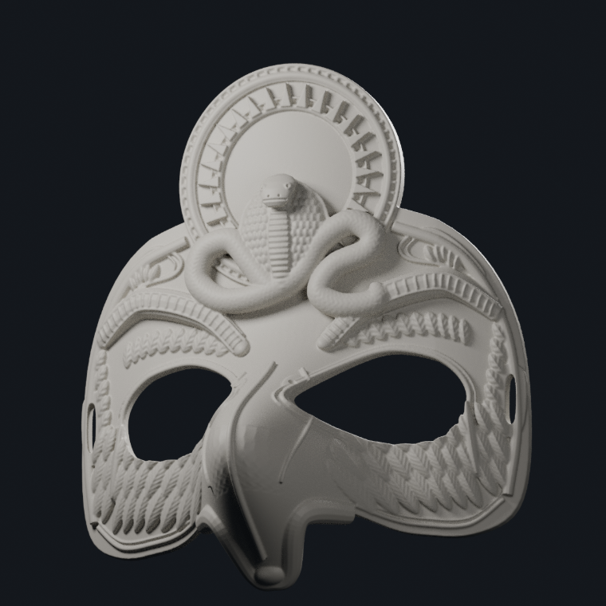
My daughter wanted to be Ra.
01 / Beyond code
Costume day. A 3D printer. No mask.
New · Not just code. Real things.
Tried · GPT-6 Astra did the 3D.
Daily · Pick the model for the job.
Rendered by Codex from the actual 3D model
05
Notes:
[5:04 · 1 minute · tell it as a story, slowly] Let me show you what “does the work” really means. My daughter had Egyptian costume day at school. She wanted to go as Ra, the sun god. We have a 3D printer at home. What we didn’t have was a mask, or any idea how to make one. So we asked Codex. That’s the mask on the right. Sun disc. Cobra. Carved feathers. Rendered from the actual 3D model it built. NEW: “This isn’t a coding story. It’s a costume-day story. Codex helps with real things, not just software.” TRIED IT: “We used GPT-6 Astra for this one. The newest models are genuinely good at 3D and spatial work, things that were out of reach a year ago.” DAILY: “Match the model to the job. For hard visual or 3D work, it’s worth the heavier model; for quick edits, it isn’t.”

Slide 6
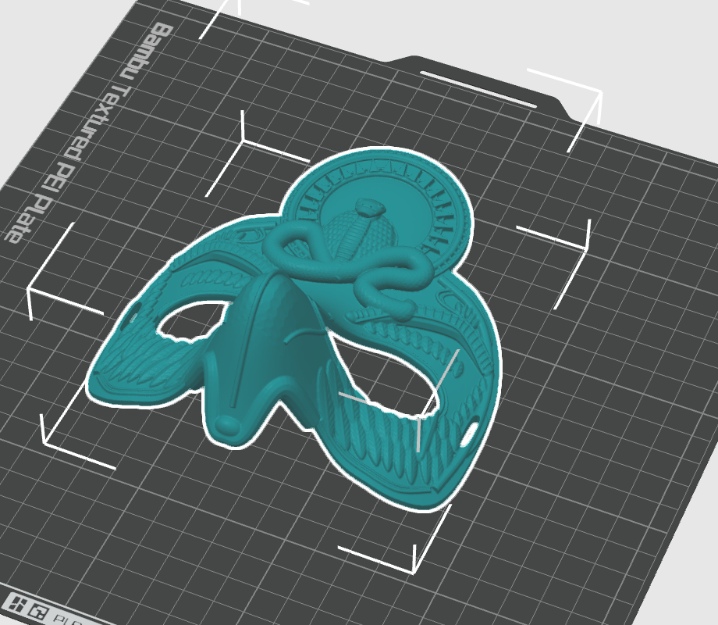
Measure. Model. Check. Print.
01 / Beyond code
1
Measure her face
It told us exactly what to measure.
2
Model it in Blender
Print files, an editable file and a guide.
3
Check it in the slicer
Plate, filament and quality in Bambu Studio.
4
Print
One click. It’s printing right now.
New · From idea to object.
Tried · Ask for the editable file.
Daily · Render close-ups first.
Codex with GPT-6 Astra · Blender · Bambu Studio · Bambu Lab P1S
06
Notes:
[5:05 · 1 minute] Four steps. Measure. Model. Check. Print. It walked us through measuring her face. It built the mask in Blender and handed back three things: the print files, the editable Blender file, and a guide. We opened it in Bambu Studio, the printer’s software, checked the plate and the filament, and clicked print. It’s printing right now. Let’s go and look. NEW: “From an idea at the kitchen table to an object you can hold. No 3D skills needed.” TRIED IT: “Always ask for the editable source, not just the final file. Here, that’s the Blender file, so we can tweak it next year.” DAILY: “Before committing hours of printer time, ask for renders and close-ups. Reviewing pixels is cheaper than reviewing plastic.”

Slide 7
Is it done yet?
01 / Live
In ChatGPT, ask:
“Open Bambu Studio and tell me how far the Ra mask print has got and how long is left. Don’t change anything.”
New · It can use your apps.
Tried · It reads the screen, then acts.
Daily · Set limits in the prompt.
Live: minimise the slides → ChatGPT → ask
07
Notes:
[5:06 · 2 minutes · LIVE] BEFORE DOORS: the print is running. In the ChatGPT desktop app, confirm it can control your Mac (computer use enabled, macOS Screen Recording and Accessibility granted) and that Bambu Studio is allowed. Close Bambu Studio so the audience sees it open. Run the prompt once in rehearsal. Keep the Bambu Handy app on your phone and the slicer screenshot (previous slide) as fallbacks. ON STAGE: 1. “The mask is printing at home right now. Let’s ask.” 2. Minimise the slides. Open ChatGPT. Paste the prompt. Send. 3. Narrate as it works: “It’s opening the app… finding the Device tab… reading the progress.” 4. Read out its answer: percentage and time left. Check it against the screen yourself. 5. Back to the slides. NEW: “It didn’t just answer a question. It opened an app on my computer and looked for me.” TRIED IT: “It works like you would: it looks at the screen, decides what to click, then reads the result. Hold that thought; it’s the loop I’ll show you in two minutes.” DAILY: “When you let it near real apps, set the boundary in the prompt. ‘Don’t change anything’ turns a risky task into a read-only check.” FALLBACK (30 seconds max): “The printer’s being shy.” Open Bambu Handy on your phone, or go back one slide, and keep moving.

Slide 8
Three modes. One app.
01 / Codex
Chat
Work
Codex
Think it through.
Get the finished file.
See all the working.
New · Today, pick Codex.
Tried · Work and Codex share limits.
Daily · Want diffs? Use Codex.
Source: learn.chatgpt.com/docs/use-chatgpt
08
Notes:
[5:09 · 45 seconds] Three modes. One app. Chat to think. Work for the finished file. Codex to see every step. NEW: “Today, just pick Codex. Everything we show lives there.” TRIED IT: “Work and Codex are close cousins: same kind of agent, same usage limits. Codex simply shows you more of the working.” DAILY: “Reviewing changes? Stay in Codex. You get diffs you can click, not paragraphs you have to trust.” [UI: point to the mode switcher in the desktop app.]

Slide 9

Plan. Act. Check. Repeat.
01 / How it works
Plan
In
Your task.
until done
Check
Act
Out
A result you review.
New · It checks its own work.
Tried · Give it a test to pass.
Daily · New task, new chat.
Source: Michael Bolin, “Unrolling the Codex agent loop”, OpenAI, Jan 2026
09
Notes:
[5:10 · 1.5 minutes · the one diagram to remember] This is how Codex works. Plan. Act. Check. Repeat. It plans a step, uses a tool, like running a command or editing a file, reads the result, and goes again. It stops when it has nothing left to do. Then it’s your turn to review. NEW: “It doesn’t just guess once. It checks its own work and tries again.” TRIED IT: “When it ‘fixes its own mistake’, it ran something and read the error. So give it something to check against: a test, a sample input, ‘open it at phone width’.” DAILY: “Every step it takes gets added to the chat. Long chats fill up and drift. New task, new chat.” Safety in one breath: it works freely inside the folder you give it, and asks before going further. Keep the default, “Ask for approval”, until you trust your setup.

Slide 10
Three habits. One each.
01 / Habits
New
Tried
Daily
Say what “done” looks like.
Plan before it builds.
Write your rules down once.
Goal. Context. Constraints. Done when.
/plan or Shift+Tab
AGENTS.md
Source: Codex best practices, learn.chatgpt.com/guides/best-practices
10
Notes:
[5:12 · 1 minute] Three habits. One for each of you. All from OpenAI’s own best-practice guide. NEW: “Tell it what ‘done’ looks like. Goal, context, constraints, done when. Four short lines beat one long paragraph.” TRIED IT: “For anything fuzzy, make it plan first: type /plan or press Shift+Tab, agree the plan, then let it build. Or say ‘interview me first’.” DAILY: “Stop repeating yourself. Put house rules in an AGENTS.md file in your project; Codex reads it before every task. Keep it short. When it makes the same mistake twice, ask for a retrospective and have it update the file.” Bonus for purple: run /review before you ship, and turn any workflow you repeat into a skill.

Slide 11
02 / Why it’s different
It acts.
It checks.
It shows its work.
New · It does, not just says.
Tried · Every change is a diff.
Daily · Comment on a diff line.
Cambridge Codex Community
11
Notes:
[5:14 · 45 seconds] Why does this feel different from every chatbot you’ve used? Three things. It acts. It checks. It shows its work. NEW: “It doesn’t tell you what to do. It does it, then shows you.” TRIED IT: “Nothing is hidden. Every change is a diff and every command is logged, so you can review it like an analyst’s spreadsheet.” DAILY: “Don’t retype feedback. In the desktop app, click the exact line in the diff and comment on it; it goes straight into the next turn.”

Slide 12

02 / What counts as work
1 in 5
Codex users aren’t developers.
New · You don’t need to code.
Tried · Analysis, research, documents.
Daily · Run tasks in parallel.
Source: OpenAI, 2 June 2026, at 5M+ weekly Codex users
12
Notes:
[5:16 · 45 seconds · pause after the number] One in five. In June, one in five Codex users weren’t developers. And that group was growing more than three times faster. NEW: “If you don’t code, you’re not a guest here. You’re the fastest-growing group.” TRIED IT: “The top non-code jobs, per OpenAI: data analysis, research, and writing documents like reports, spreadsheets and decks.” DAILY: “Heavy users don’t wait. They run several tasks at once: one researching, one drafting, one cleaning data.”

Slide 13
Work is bigger than code.
02 / What counts as work
Code
Everything else
Features.
Bugs.
Reviews.
Research. Spreadsheets.
Decks. Market models.
Websites.
New · A file, a page, data? Try it.
Tried · Underneath, it writes code.
Daily · Keep the script. Rerun it.
Cambridge Codex Community
13
Notes:
[5:17 · 1.5 minutes · ask the room for one boring task] Code is features, bugs and reviews. Everything else is the stuff this room does every week: research, spreadsheets, decks, market models, websites. NEW: “Simple test: if the result is a file, a page, or an answer backed by data, try Codex.” TRIED IT: “Here’s the secret. Ask it to clean a spreadsheet and it quietly writes a small script, runs it and checks the totals. That’s why it’s more reliable than a chatbot doing maths in its head.” DAILY: “So keep the script. Ask it to save it, and next week’s version of the job takes one line.” [Ask: “Shout out one boring task from your week.” Say which side of the slide it lives on.]

Slide 14

03 / Rate of change
120+
updates since May 2025.
New · Learn ideas, not buttons.
Tried · Seven in one week this month.
Daily · Skim the changelog weekly.
Source: learn.chatgpt.com/docs/changelog
14
Notes:
[5:19 · 45 seconds] More than 120 updates since May last year. Roughly one every four days. NEW: “Nobody keeps up with all of it. Learn the ideas, because the buttons will move.” TRIED IT: “Between 8 and 15 October alone there were seven: a new app build, three CLI releases, an Ultrafast mode, message predictions, and a model retired.” DAILY: “Make it a Friday habit: five minutes on learn.chatgpt.com/docs/changelog. Most entries are small wins you’d otherwise miss.”

Slide 15
From autocomplete to agent.
03 / Rate of change
2021
Apr 2025
May 2025
Feb 2026
May–Jun 2026
Today
Code completion
Terminal agent
Cloud agent
Desktop app
Appshots, Sites
You.
New · From typing help to doing.
Tried · Our demos: 5 months old.
Daily · Update the app often.
Selected milestones · OpenAI announcements and changelog
15
Notes:
[5:20 · 45 seconds] 2021: Codex was a model that finished your lines of code. 2025: an agent in your terminal, then in the cloud. This year: a desktop app, then Appshots and Sites, the two green ones we’ll demo. And today: you. NEW: “It went from helping you type to doing the whole task.” TRIED IT: “Appshots and Sites, our two demos, are less than five months old. That’s the pace.” DAILY: “New features land in app builds every week or two. Update often, or you’re working with last month’s Codex.”

Slide 16

2 million to 40 million.
03 / Rate of change
2M
5M
10M
20M
40M
Mar
Jun
Jul
Aug
Oct
New · You’re early, not late.
Tried · Weekly became active users.
Daily · Milestones bring resets.
Sources: OpenAI (Mar, Jun, Jul) · Tibo Sottiaux on X (Aug, Oct) · 2026
16
Notes:
[5:21 · 45 seconds · let the circles do the talking] March: two million. June: five. July: ten. August: twenty. October: forty million. NEW: “Tens of millions of people use this. You’re early, not late.” TRIED IT: “Analyst’s footnote: the measure changed along the way, from weekly Codex users to active users across Codex, Work and ChatGPT. Trust the direction, not the curve.” DAILY: “Each milestone tends to come with a usage reset from Tibo. Which brings us to limits.” [If asked: the 2 June figure, 5M+ weekly Codex users, is the last clearly defined weekly number from OpenAI.]

Slide 17
Learn the loop, not the model.
03 / Models
Luna
Quick
350–3,000
16
Sol
Daily driver
15–160
Astra
Hardest jobs
5–45
new models in a year.
messages per 5 hours on Plus
New · Ignore the menu for now.
Tried · Pick it before you start.
Daily · Astra burns 3× faster.
OpenAI estimates for GPT-6 Luna, GPT-6.1 Sol and GPT-6 Astra · learn.chatgpt.com/docs/pricing
17
Notes:
[5:22 · 1 minute] Sixteen new models in Codex in about a year. One was switched off three days ago. So: learn the loop, not the model. NEW: “Ignore the model menu for now. The default is fine.” TRIED IT: “Pick the model before you start. Switching mid-chat makes the new model re-read everything from scratch.” DAILY: “Mind the exchange rate. On Plus, OpenAI estimates 15 to 160 messages per five hours on Sol, but only 5 to 45 on Astra. That’s about three times faster burn. Default to Sol, drop to Luna for quick jobs, save Astra for the hard stuff. And Fast mode costs 2.5×, Ultrafast 8×.”

Slide 18
Two meters. One pot.
03 / Limits
Every 5 hours
Check yours
Settings → Usage
Every week
New · Run out? It refills.
Tried · Work and Codex share it.
Daily · /status mid-task.
Meters are illustrative · learn.chatgpt.com/docs/pricing
18
Notes:
[5:23 · 1 minute, including 20 seconds in the app] Two meters: one refills every five hours, one every week. One pot. NEW: “Hit the limit? Don’t panic. It refills, and paid plans can top up with credits.” TRIED IT: “Work and Codex, on your laptop and in the cloud, all draw from the same pot. Pro plans currently skip the five-hour meter.” DAILY: “In the terminal, type /status mid-task to see what’s left before you start something big.” [SWITCH TO APP: open Settings → Usage. Point at both meters. Switch back.]

Slide 19
Meet Tibo.
03 / Insider tip
60+
Tibo Sottiaux leads Codex at OpenAI. Follow @thsottiaux.
limit resets since 2025.
New · Limits reset. Often early.
Tried · Banked resets wait for you.
Daily · Spend one only when empty.
Sources: OpenAI Help, “How banked Codex resets work” · opentherank.com/codex-reset
19
Notes:
[5:24 · 1 minute · have fun with this one] Meet Tibo. Thibault Sottiaux, the OpenAI product lead behind Codex. In the community he’s famous for one thing: resetting everyone’s usage limits. Over sixty times since September 2025. After outages. After launches. At user milestones. Sometimes just because. The latest was two days ago. NEW: “Ran out? Check his feed. Limits often reset early, for everyone.” TRIED IT: “Some resets are ‘banked’: saved to your account until you choose to use them. You’ll see ‘1 reset available’ in Settings → Usage.” DAILY: “Don’t spend a banked reset at 10% used. It refreshes both meters and moves your weekly reset date, and it expires. Spend it when you’re nearly out and your normal reset is days away.” [SWITCH TO APP if you have one: show the ‘reset available’ line. Don’t apply it on stage.]

Slide 20
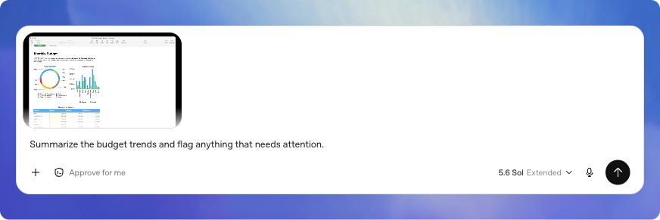
Show what you mean.
04 / Appshots
Command
+
Command
Both at once. Windows: both Alt keys.
Illustration: OpenAI docs
New · Don’t describe it. Show it.
Tried · It reads below the scroll.
Daily · Stack several in one chat.
Source: learn.chatgpt.com/docs/appshots
20
Notes:
[5:25 · 45 seconds] Demo time. The feature almost nobody uses, and everybody loves once they’ve seen it. Appshots. Press both Command keys, and the window in front of you lands in ChatGPT. NEW: “Don’t describe your screen. Show it. Two keys.” TRIED IT: “It’s not just a screenshot. It sends the window’s text too, even the part below the scroll. (Google Docs, Sheets and Gmail may send only the picture; a plugin fixes that.)” DAILY: “Take several in a row. Within a minute, they stack into the same chat, so you can show three windows and ask one question.” Privacy: it sends what’s in that window. Close your bank tab first. On a Mac, grant Screen Recording and Accessibility once.

Slide 21
One window. One question.
04 / Live
On our Watch & learn page, press both Command keys, then ask:
“I have 15 minutes. Which two video moments should I watch first? Give the timestamps.”
New · Show, then ask.
Tried · Check it against the page.
Daily · Docs or Gmail? Add the plugin.
No permissions? Attach an ordinary screenshot instead, and say so.
21
Notes:
[5:26 · 2 minutes · LIVE] BEFORE DOORS: confirm Appshots works in the desktop app (Settings → hotkey; on Mac grant Screen & System Audio Recording and Accessibility, restart the app). Set Appshot destination to “New chat”. Open codex.cambridgecombinator.com/interviews.html in a clean window, no other tabs. Mute notifications. Copy the prompt. ON STAGE: 1. “Five long interviews. Fifteen minutes. Which ones?” Scroll to show it’s long, then back to the top. 2. Press both Command keys. “That’s it.” Show the attachment before sending. 3. Paste the prompt. Send. 4. Read the two picks. Scroll to one timestamp on the real page. “Does 23:44 really say that? Yes. Checked.” If it’s wrong, say so: that’s the lesson too. NEW: “Show, then ask. That’s the whole move.” TRIED IT: “Never trust, always check: I just scrolled to the timestamp to confirm it.” DAILY: “For Google Docs, Sheets or Gmail, install the matching plugin, so Codex gets the full text rather than just the screenshot.” Payoff line: “Showing beats describing. Checking beats trusting.” FALLBACK (15 seconds max): drag in a normal screenshot and say “plain screenshot, not an Appshot”. It sees only what’s visible: a nice contrast.

Slide 22
Small things. Big wins.
04 / Hidden gems
New
Tried
Daily
Voice
/review
Tab
A second pass before you ship.
Accept its guess at your next message.
Talk instead of typing.
Sources: Codex changelog (Tab predictions, beta, 9 Oct) · learn.chatgpt.com docs
22
Notes:
[5:28 · 30 seconds] Three small things. Three big wins. One for each of you. NEW: “Voice. Talk to it instead of typing, even while it’s working. Set a hotkey in Settings → Voice.” TRIED IT: “/review. Before you ship anything, ask for a second pass on your changes against a branch, a commit or what’s uncommitted.” DAILY: “Tab. Since 9 October, Codex predicts your next message in the desktop app. Press Tab to accept. It’s in beta, and it adds up fast.” Bonus: you can approve and steer tasks from the ChatGPT iOS app. Right. One more thing.

Slide 23
One more thing.
Notes:
[5:28 · 5 seconds · pause, let it land] “One more thing.” [Pause two beats. Click.]

Slide 24

Give your idea a home.
05 / Sites
Describe it.
Get a link.
Our own community site was built this way.
New · No code. No servers.
Tried · Real database and sign-in.
Daily · Host what you’ve built.
Example Sites · image: OpenAI · learn.chatgpt.com/docs/sites
24
Notes:
[5:28 · 45 seconds] ChatGPT Sites. Describe a website. Get a link. That’s it. Our own community site, codex.cambridgecombinator.com, was built this way; it says so in the footer. NEW: “No code, no servers, no hosting account. You describe it, Codex builds it and hosts it.” TRIED IT: “It’s more than a page. Every Site can have a real database and sign-in, so it can remember scores, sign-ups or votes.” DAILY: “Already built something in Codex? Say ‘Deploy this project with Sites’ and skip the hosting set-up.” Launched in June, reached UK Plus and Pro users on 20 July. About three months old.

Slide 25
Five steps. One link.
05 / Sites
1
2
3
4 · goes live
5
Describe
Preview
Refine
Deploy
Share
New · Start with “@Sites”.
Tried · Deploy is live. No staging.
Daily · “Save a version, don’t deploy.”
ChatGPT desktop app or chatgpt.com/sites · Plus, Pro, Business, Enterprise
25
Notes:
[5:29 · 45 seconds] Five steps. One link. Describe. Preview. Refine. Deploy. Share. NEW: “Start your message with @Sites, or just use the word ‘website’, and Codex knows what you want.” TRIED IT: “Step four is the one to respect. Every deployment URL is live. There is no staging area. Review first.” DAILY: “Say ‘save a version without deploying’. You keep a snapshot to compare or roll back to, and nothing goes live until you decide.” Where: the ChatGPT desktop app, or chatgpt.com/sites. Who: Plus, Pro, Business, Enterprise. Not Free or Go; we have a workaround for you in the hands-on.

Slide 26
You choose who sees it.
05 / Sites
Everyone
Your workspace
Chosen people
Just you
New · It starts private.
Tried · Outsiders can only view.
Daily · Editors can publish. Few.
“Everyone” needs public publishing switched on · ChatGPT Sites help
26
Notes:
[5:30 · 30 seconds] You choose who sees it. Just you. Chosen people. Your workspace. Everyone. NEW: “Every Site starts private: just you. Nothing is public until you say so.” TRIED IT: “Invite people outside your workspace and they can view, never edit. ‘Everyone on the internet’ only appears if public publishing is switched on.” DAILY: “Editors can publish and can see the live database. Keep that list short. And remember: restoring an old version brings back the code, not the data.”

Slide 27
More than a page.
05 / Under the hood
Database
Sign-in
Your apps
Payments
Up to 10 GB
With ChatGPT
Each visitor’s own
Via a provider
New · It can remember things.
Tried · Your data stays yours.
Daily · Records in the database only.
Connected apps: workspace-private Sites only · learn.chatgpt.com/docs/sites
27
Notes:
[5:31 · 30 seconds] More than a page. A database. Sign-in. Your visitors’ own apps. Payments. NEW: “Your Site can remember things: scores, sign-ups, votes. Up to 10 GB.” TRIED IT: “On workspace Sites, each visitor connects their own accounts, so one page can show everyone their own data. Sharing the Site never shares yours.” DAILY: “Keep real records, like submissions and scores, in the Site’s database. Not in the page, and not for throwaway things like a theme toggle. Hiding a button doesn’t protect data.” Payments only through a third-party provider. Off-limits: health records, under-13s, impersonation. Hosting is included on Plus and Pro; building uses your normal Codex allowance.

Slide 28
Four lines. Better results.
05 / The brief
Goal
A market-sizing practice site
Context
For MBA students before interviews
Constraints
No sign-in. Works on a phone.
Done when
I can draw a question and time myself
New · Say what done looks like.
Tried · Constraints stop surprises.
Daily · “Flag gaps. Don’t invent.”
Source: Codex best practices · Sites “Create a site” guide
28
Notes:
[5:32 · 45 seconds] Four lines. Better results. Goal. Context. Constraints. Done when. It’s OpenAI’s own structure, and it’s the brief for our live build. NEW: “The line people skip is ‘done when’. Say what success looks like, and Codex can check itself against it.” TRIED IT: “Constraints are where the surprises go to die: no sign-in, no personal data, must work on a phone.” DAILY: “Add one more line to every brief: ‘If anything is missing, flag it instead of inventing it.’ It saves a round of corrections every time.”

Slide 29
Let’s build Sizing Sprint.
05 / Live
Paste into Codex
@Sites Build a website called Sizing Sprint where MBA students practise market-sizing questions. Include eight example questions. Let me draw a random one, start a 3-minute timer, note my estimate, then reveal a sample structure. No sign-in. Works on a phone. If anything is missing, flag it instead of inventing it. Save a version; don’t deploy yet.
New · Watch it plan, build, test.
Tried · One change. Then check it.
Daily · Show a screenshot of a style.
Sample answers are practice material, not real market data.
29
Notes:
[5:33 · 5 minutes · LIVE, the centrepiece] BEFORE DOORS: sign in on the presenting laptop and confirm Sites is there (desktop app → Sites, or chatgpt.com/sites). Run this exact prompt once and SAVE that version as your fallback. Check your usage meter. Zoom the app to about 125%. ON STAGE: 1. New Codex task in the desktop app. Paste. Send. “Watch it plan, write files, and test its own work. That’s the loop.” 2. While it builds, narrate. If it asks a question, answer out loud. 3. Preview appears: draw a question, start the timer, type an estimate, reveal. Ask the room: “What would you check?” 4. ONE follow-up: “Add a difficulty filter: easy, medium, hard.” 5. Narrow the window to phone width. 6. Show where Share lives. Don’t publish on stage. NEW: “Watch the left side. That’s Codex planning, building and testing, the loop from earlier.” TRIED IT: “One change at a time, then check that change. Small steps beat a giant rewrite.” DAILY: “Want it to look a certain way? Don’t write adjectives. Drop in a screenshot of a site you like and say ‘in this style’.” TIME GUARD: nothing by 5:36? “Here’s one I made earlier.” Open the saved version and make the follow-up there. Never debug live for more than 30 seconds.

Slide 30
Click it. Break it. Ship it.
05 / Before you share
Click
Break
Ship
every button, on a phone too.
it with an empty or silly input.
to the right audience, on purpose.
New · You are the final test.
Tried · No secrets, no personal data.
Daily · Retest the live link.
Source: Sites “Create a site” guide
30
Notes:
[5:37 · 30 seconds · then straight into the hands-on] Click it. Break it. Ship it. NEW: “Codex tests its work, but you are the final test. Click every button. Try it on your phone.” TRIED IT: “Try to break it: an empty box, a silly number. And make sure there are no secrets or personal data inside.” DAILY: “Once it’s live, open the published link as a visitor would and test again. A preview that works isn’t a deploy that works.” Two assistants agreeing doesn’t prove it works. You clicking it does.

Slide 31
Your turn.
06 / Hands-on · 5:38–5:53
15 minutes
New
Tried
Daily
Paste a starter. Change one thing.
Build your own idea in four lines.
Make it remember: add a leaderboard.
Free or Go plan? Ask for “a single index.html in this folder” instead. Pairs welcome.
31
Notes:
[5:38 · announce in 45 seconds, then leave the next slide up] Your turn. Fifteen minutes. Find your dot. NEW: “Blue: paste a starter prompt from the next slide, watch it build, then change one thing and check it on your phone.” TRIED IT: “Orange: build your own idea. Goal, context, constraints, done when. Four lines.” DAILY: “Purple: make it remember. Add a leaderboard that saves to the Site’s database, with optional Sign in with ChatGPT.” On Free or Go? No Sites on your plan yet, but you have Codex: make an empty folder and ask for “a single index.html page”, then open it in your browser. Same skills, no hosting. Pairs are great: one drives, one tries to break it. FACILITATION: 5:43 check everyone has something building. 5:48 “Five minutes: one change, then check it.” 5:51 “Two minutes. Who’s showing?” Line up three volunteers.

Slide 32
Copy. Paste. Build.
06 / Hands-on
New · Sizing Sprint
Tried · Your idea
Daily · Level up
@Sites Build a website where I practise market-sizing questions: a random question, a 3-minute timer, a notes box and a button that reveals a sample answer. Works on a phone.
@Sites Goal: [what]. Context: [who it’s for]. Constraints: [what to avoid]. Done when: [your test]. Flag anything missing instead of inventing it.
Add a leaderboard that saves scores in the Site’s database. Offer optional Sign in with ChatGPT so people see their own history. Save a version; don’t deploy.
Then: one change → check it → repeat
32
Notes:
[5:39–5:53 · leave this slide up during the hands-on] Copy. Paste. Build. One prompt per dot. NEW: “Blue: Sizing Sprint, the one we just built. Guaranteed win. Then make it yours: change the topic or the timer.” TRIED IT: “Orange: your own idea, in the four lines. Goal, context, constraints, done when.” DAILY: “Purple: take any Site and make it remember. A leaderboard in the database, plus optional Sign in with ChatGPT.” Whatever you pick: one change, check it, repeat. [Share the deck link or a QR code now so people can copy the prompts.]

Slide 33
Show and tell.
06 / 5:53–5:57
Three people. Sixty seconds each.
New · What you made.
Tried · One change you asked for.
Daily · How you checked it.
A useful bug counts as a win.
33
Notes:
[5:53 · 4 minutes · strict timekeeping] Hands off keyboards. Three people. Sixty seconds each. NEW: “Just show us what you made. That’s enough.” TRIED IT: “Tell us one change you asked for, and whether it landed.” DAILY: “Tell us how you checked it. That’s the habit that separates good results from lucky ones.” A bug counts as a win if you found it. One host runs mic and timer; the other asks one follow-up: “What would you change next?” Hard stop at 5:57.

Slide 34
Three videos. One each.
07 / Watch and learn
New
Kath Korevec on Sites
11:27
Tried
Tibo Sottiaux on judgment
23:44
Daily
Itamar Friedman on review
10:15
All on codex.cambridgecombinator.com → Watch & learn
Plus two on Dots: Sam Altman, and Alexander Embiricos
34
Notes:
[5:57 · 45 seconds] Three videos. One for each of you. All on our site under Watch & learn, with the best moments marked. NEW: “Kath Korevec from OpenAI with Claire Vo, from 11:27: why a small tool for one trip or one weekend is enough. Perfect after today.” TRIED IT: “Tibo with Lenny Rachitsky, from 23:44: why knowing your audience and having taste matter more now, not less.” DAILY: “Itamar Friedman from Qodo, from 10:15: two AIs agreeing doesn’t prove it works. How to review AI-built work properly.” Plus two on Dots, with Sam Altman and Alexander Embiricos: the topic of our next workshop.

Slide 35
Take it home.
07 / After today
Take-home challenge
Next · Wed 28 Oct
Make it about something you care about.
Make everyday work easier.
Due Sun 25 Oct, 11:59pm
New · Rebuild it for your club.
Tried · Prompt, change, test: submit.
Daily · Turn it into a skill.
Submit via Challenges at codex.cambridgecombinator.com
35
Notes:
[5:58 · 45 seconds] Take it home. Make today’s build about something you care about. Due Sunday 25 October, 11:59pm UK time, through Challenges on our site. Your entry is private to you and the organisers. And next: Wednesday 28 October, Make everyday work easier: Voice, useful drafts and a first look at Dots. NEW: “Rebuild today’s idea for your club, your job search or your next case interview.” TRIED IT: “Submit three things: the prompt you used, one change you made, and what you tested.” DAILY: “Found a workflow you’ll repeat? Turn it into a skill, a SKILL.md file, so next time it’s one line.” [HOSTS: if attendee OpenAI credits are being handed out, say how to claim them here.] [CHECK: the Challenges page still says “adapt the checklist”. Update it, or say “whatever you built today”.]

Slide 36
Questions?
Cambridge Codex
Community
Now go build something useful.
codex.cambridgecombinator.com
learn.chatgpt.com/docs
Notes:
[5:59 · questions until 6:00] Questions? Then go build something useful. NEW: “You built something today. Next time you think ‘I wish there was a tool for this’, describe it to Codex.” TRIED IT: “Remember the loop. When results surprise you, ask: what could it check, and what did I forget to tell it?” DAILY: “Three tips to take home: pick your model up front, keep rules in AGENTS.md, and save banked resets for when you’re nearly out.” Links: codex.cambridgecombinator.com for the videos, the challenge and the next workshop; learn.chatgpt.com/docs when the buttons move. [Hard stop at 6:00. Thank the room and the venue.]

